Slide 1
UML Class Diagram and Packages

Slide 2
Agenda
What is a Class Diagram?
Essential Elements of a UML Class Diagram
Packages and Class Diagrams
Analysis Classes Approach
Tips

Slide 3
What is a Class Diagram?
A class diagram describes the types of objects in the system and the various kinds of static relationships that exist among them.
  A graphical representation of a static view on declarative static elements.
A central modeling technique that runs through nearly all object-oriented methods.
The richest notation in UML.

Slide 4
Essential Elements of a UML Class Diagram
Class
Attributes
Operations
Relationships
  Associations
  Generalization
  Dependency
  Realization
Constraint Rules and Notes

Slide 5
Classes
A class is the description of a set of objects having similar attributes, operations, relationships and behavior.
Class Name
Window
size: Size
visibility: boolean
Attributes
display()
hide()
Operations

Slide 6
Associations
A semantic relationship between two or more classes that specifies connections among their instances.
A structural relationship, specifying that objects of one class are connected to objects of a second (possibly the same) class.
Example: “An Employee works for a Company”
Employee
Department
Company

Slide 7
Associations (cont.)
An association between two classes indicates that objects at one end of an association “recognize” objects at the other end and may send messages to them.
  This property will help us discover less trivial associations using interaction diagrams.

Slide 8
Associations (cont.)
Role name
Association name
instructor
StaffMember
Student
1..*
instructs
*
Role
Navigable
(uni-directional) association
Multiplicity
*
pre -
requisites
Courses
0..3
Reflexive association

Slide 9
Associations (cont.)
To clarify its meaning, an association may be named.
  The name is represented as a label placed midway along the association line.
  Usually a verb or a verb phrase.
A role is an end of an association where it connects to a class.
  May be named to indicate the role played by the class attached to the end of the association path.
    Usually a noun or noun phrase
    Mandatory for reflexive associations

Slide 10
Associations (cont.)
Multiplicity
  The number of instances of the class, next to which the multiplicity expression appears, that are referenced by a single instance of the class that is at the other end of the association path.
  Indicates whether or not an association is mandatory.
  Provides a lower and upper bound on the number of instances.

Slide 11
Associations (cont.)
  Multiplicity Indicators
Exactly one | 1
Zero or more (unlimited) | * (0..*)
One or more | 1..*
Zero or one (optional association) | 0..1
Specified range | 2..4
Multiple, disjoint ranges | 2, 4..6, 8

Slide 12
Aggregation
A special form of association that models a whole-part relationship between an aggregate (the whole) and its parts.
  Models a “is a part-part of” relationship.
2..*
Door
1..*
Car
House
Whole
Part

Slide 13
Aggregation (cont.)
Aggregation tests:
  Is the phrase “part of” used to describe the relationship?
    A door is “part of” a car
  Are some operations on the whole automatically applied to its parts?
    Move the car, move the door.
  Are some attribute values propagated from the whole to all or some of its parts?
    The car is blue, therefore the door is blue.
  Is there an intrinsic asymmetry to the relationship where one class is subordinate to the other?
    A door is part of a car. A car is not part of a door.

Slide 14
Composition
A strong form of aggregation
  The whole is the sole owner of its part.
    The part object may belong to only one whole
  Multiplicity on the whole side must be zero or one.
  The life time of the part is dependent upon the whole.
    The composite must manage the creation and destruction of its parts.
Circle
1
Point
Circle
Point
Polygon
3..*

Slide 15
Generalization
Indicates that objects of the specialized class (subclass) are substitutable for objects of the generalized class (super-class).
  “is kind of” relationship.
{abstract} is a tagged value that indicates that the class is abstract.
The name of an abstract class should be italicized
An abstract class
Shape
{abstract}
Super Class
Generalization relationship
Sub Class
Circle

Slide 16
Generalization
A sub-class inherits from its super-class
  Attributes
  Operations
  Relationships
A sub-class may
  Add attributes and operations
  Add relationships
  Refine (override) inherited operations
A generalization relationship may not be used to model interface implementation.

Slide 17
Dependency
A dependency indicates a semantic relation between two or more classes in which a change in one may force changes in the other although there is no explicit association between them.
A stereotype may be used to denote the type of the dependency.
Iterator
<<friend>>
Vector

Slide 18
Realization
A realization relationship indicates that one class implements a behavior specified by another class (an interface or protocol).
An interface can be realized by many classes.
A class may realize many interfaces.
LinkedList
<<interface>>
List
LinkedList
List

Slide 19
Constraint Rules and Notes
Constraints and notes annotate among other things associations, attributes, operations and classes.
Constraints are semantic restrictions noted as Boolean expressions.
  UML offers many pre-defined constraints.
Customer
id: long { value > 0 }
1
*
Order
may be canceled
{ total < $50 }
Constraint
Note

Slide 20
TVRS Example
TrafficReport
Offender
TrafficPoliceman
1
issues
*
id : long
1..*
1
name : String
description : String
id : long
occuredAt : Date
reports of
1..*
Policeman
id : long
Violation
name : String
id : long
rank : int
description : String
<<abstract>>

Slide 21
UML Packages
A package is a general purpose grouping mechanism.
  Can be used to group any UML element (e.g. use case, actors, classes, components and other packages.
Commonly used for specifying the logical distribution of classes.
A package does not necessarily translate into a physical sub-system.
Name

Slide 22
Logical Distribution of Classes
Emphasize the logical structure of the system (High level view)
  Higher level of abstraction over classes.
  Aids in administration and coordination of the development process.
  Contributes to the scalability of the system.
Logical distribution of classes is inferred from the logical architecture of the system.

Slide 23
Packages and Class Diagrams (cont.)
Add package information to class diagrams
A
F
E
D
B
G
C

Slide 24
Packages and Class Diagrams (cont.)
Add package information to class diagrams
b
a
b.a
a.A
b.b
b.a.F
b.b.E
b.b.D
a.B
b.a.G
a.C

Slide 25
Analysis Classes
A technique for finding analysis classes which uses three different perspectives of the system:
    The boundary between the system and its actors
    The information the system uses
    The control logic of the system

Slide 26
Boundary Classes
Models the interaction between the system’s surroundings and its inner workings
  User interface classes
    Concentrate on what information is presented to the user
    Don’t concentrate on user interface details
    Example:
      ReportDetailsForm
      ConfirmationDialog
  System / Device interface classes
    Concentrate on what protocols must be defined. Don’t concentrate on how the protocols are implemented

Slide 27
Entity Classes
Models the key concepts of the system
Usually models information that is persistent
Contains the logic that solves the system problem
Can be used in multiple behaviors
Example: Violation, Report, Offender.

Slide 28
Control Classes
Controls and coordinates the behavior of the system
Delegates the work to other classes
  A control class should tell other classes to do something and should never do anything except for directing
Control classes decouple boundary and entity classes
Example:
  EditReportController
  AddViolationController

Slide 29
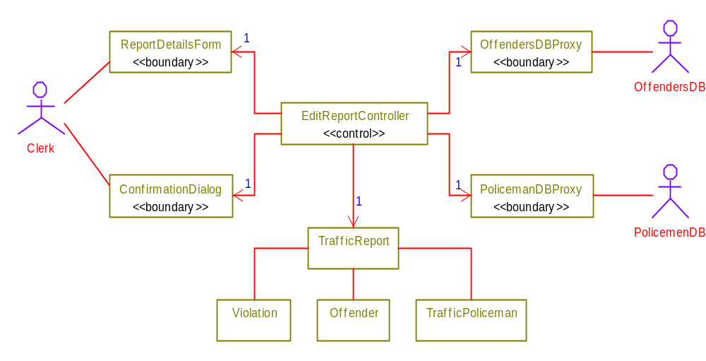
TVRS Example

Slide 30
Tips
Don’t try to use all the various notations.
Don’t draw models for everything, concentrate on the key areas.
Draw implementation models only when illustrating a particular implementation technique.

